Slide 1
Operational Amplifiers
Operational Amplifiers: Ideal v/s practical Op-amp
Performance Parameters
Op-Amp Applications
  Peak detector circuit ,
  Comparator,
  Inverting and
  Non-Inverting Amplifiers

Slide 2
Operational Amplifier, or op-amp, is a very high gain differential amplifier with high input impedance and low output impedance.
Uses:
  provide voltage amplitude changes (amplitude and polarity),
  oscillators,
  filter circuits, and
  many types of instrumentation circuits
It contains a number of differential amplifier stages cascaded together to achieve a very high voltage gain

Slide 3
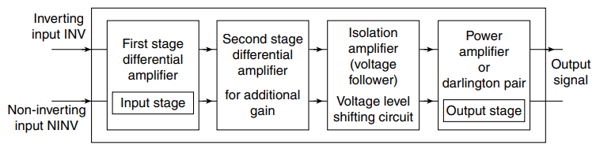
Block diagram of an Operational Amplifier
Basic building blocks inside an op amp IC are as follows:
First-stage differential amplifier.
Second-stage differential amplifier.
Voltage-level shifter.
Power output stage.

Slide 4

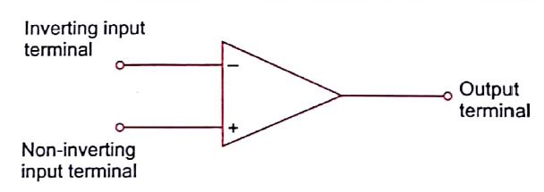
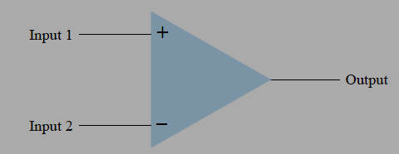
An Operational Amplifier is basically a three-terminal device which consists of two high impedance inputs.
One of the inputs is called the Inverting Input, marked with a negative or “minus” sign, ( – ).
The other input is called the Non-inverting Input, marked with a positive or “plus” sign ( + ).

Slide 5
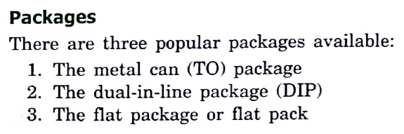
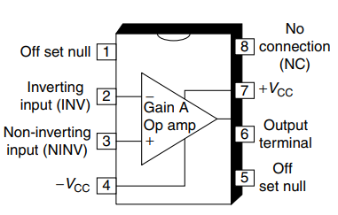
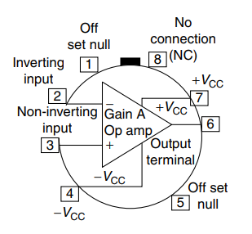
PIN configuration of Operational Amplifier

Slide 6
Pin-1: Offset null terminal.
Pin-2: Inverting (INV) input terminal. All input signals connected to this terminal on op amp will appear at the output terminal with 180° phase shift. Pin-3: Non-inverting (N-INV) input terminal. All input signals applied to this terminal on op amp appears as it is in waveform (shape) at the output terminal. Changes occur only in levels of amplitudes at the output voltage.
Pin-4: Supply voltage - VCC (negative supply voltage terminal).
Pin-5: Offset null terminal.
Pin-6: Output terminal; output signal.
1. Output signal will have 180° phase shift to input signals applied to inverting input terminal pin-2.
2. Output signal will be in-phase to input signals applied to non-inverting input terminal pin-3.

Slide 7
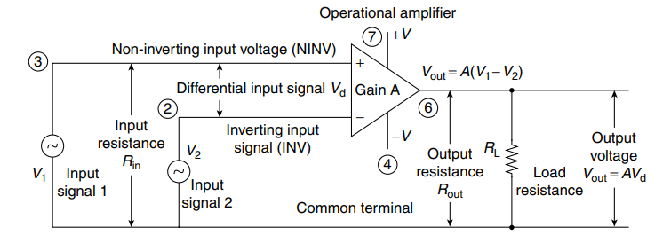
3. Output signal depends upon the voltage gain of operational amplifier.
Pin-7: supply voltage +VCC terminal (positive supply voltage terminal).
Pin-8: no connection.
SCHEMATIC DIAGRAM OF OPERATIONAL AMPLIFIER

Slide 8
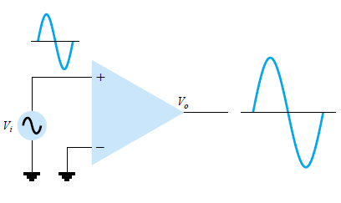
Non-inverting Input

Slide 9
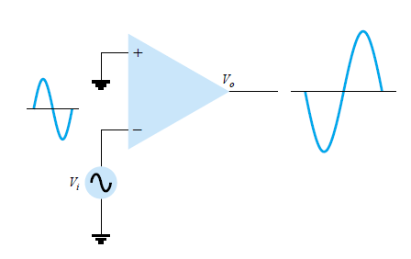
Inverting Input

Slide 10
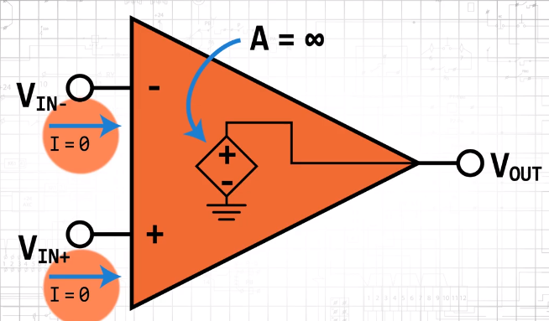
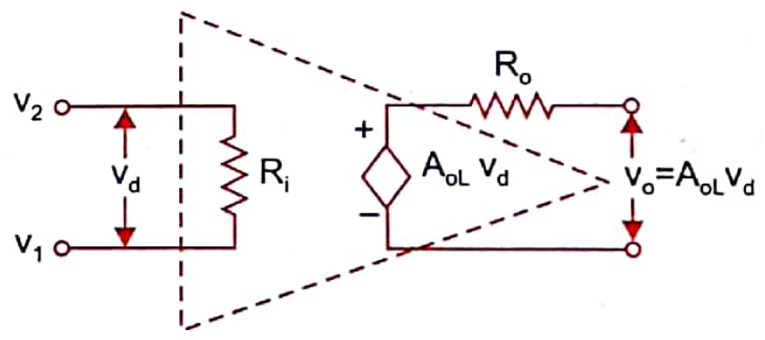


The input resistance of an op amp must be very high where as the output resistance should be quite low.
An op amp should also have very high open loop gain.
In Ideal Cases, the input resistance and open loop gain of an op amp should be infinity whereas the output resistance would be zero.

Slide 11
Characteristic | Value
Open Loop Gain (A) | ∝
Input Resistance (Impedance) | ∝
Output Resistance (Impedance) | 0
Bandwidth of Operation | ∝
Offset Voltage | 0
V_{o} = A(V₁ – V₂)
It can be observed that
An ideal op-amp allows zero current to enter into its input terminals, i.e. i₁ = i₂ = 0.
Due to infinite input impedance, any signal with source impedance can drive the op-amp without getting inflicted with any loading effect.

Slide 12
(ii) The gain of the ideal op-amp is infinite.
Hence, the voltage between the inverting and non-inverting terminals is essentially zero for a finite output voltage.
(iii) The output voltage V_{o} is independent of the output current drawn from the op-amp, since R_{o} = 0.
This means that the output can drive an infinite number of output devices of any impedance value.

Slide 13
Op-Amp Parameters
Common-mode Rejection (CMRR)
Common-mode input voltage
Input offset voltage
Input bias current
Input impedance
Input offset current
Output impedance
Slew rate

Slide 14
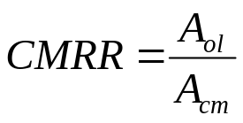
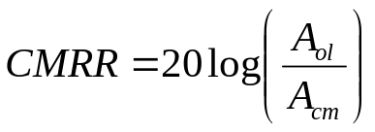
Op-Amp Parameters
Common-Mode Rejection Ratio (CMRR)
  The ability of amplifier to reject the common-mode signals (unwanted signals) while amplifying the differential signal (desired signal)
  Ratio of open-loop gain, A_{ol} to common-mode gain, A_{cm}
  The open-loop gain is a datasheet value
  The higher the CMRR, the better, in which the open-loop gain is high and common-mode gain is low.
  CMRR is usually expressed in dB & decreases with frequency

Slide 15
Op-Amp Parameters
Common-Mode Input Voltage
  The range of input voltages which, when applied to both inputs, will not cause clipping or other output distortion.
Input Offset Voltage
  Ideally, output of an op-amp is 0 Volt if the input is 0 Volt.
  Realistically, a small dc voltage will appear at the output when no input voltage is applied.
  Thus, differential dc voltage is required between the inputs to force the output to zero volts.
  This is called the Input Offset Voltage, V_{os}. Range between 2 mV or less.

Slide 16
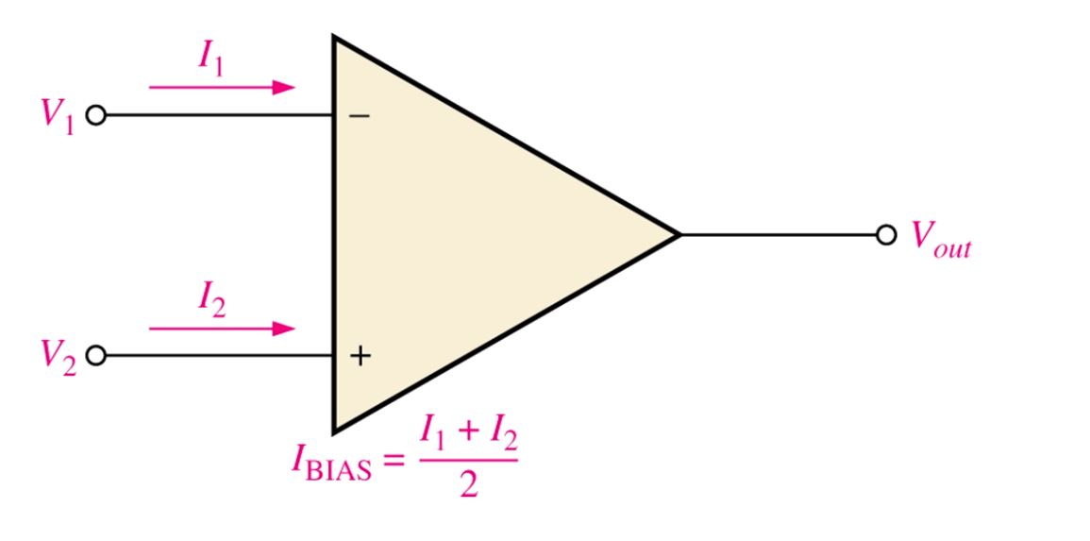
Op-Amp Parameters
Input Bias Current
  Ideally should be zero
  The dc current required by the inputs of the amplifier to properly operate the first stage.
  Is the average of both input currents

Slide 17
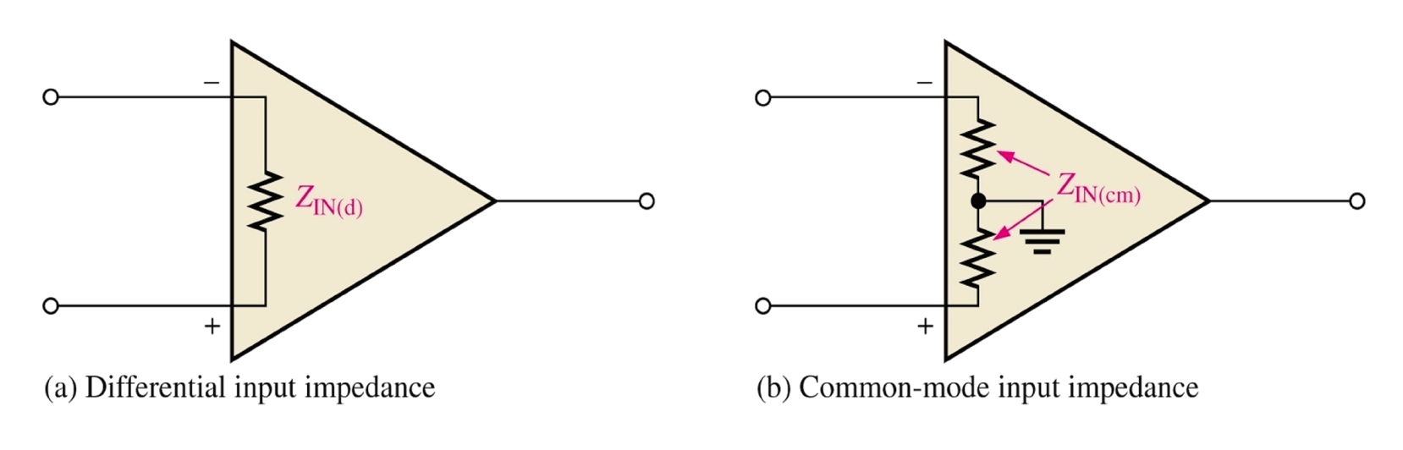
Op-Amp Parameters
Input Impedance
  Is the total resistance between the inverting and non-inverting inputs.
  Differential input impedance : total resistance between the inverting and non-inverting inputs
  Common-mode input impedance: total resistance between each input and ground

Slide 18
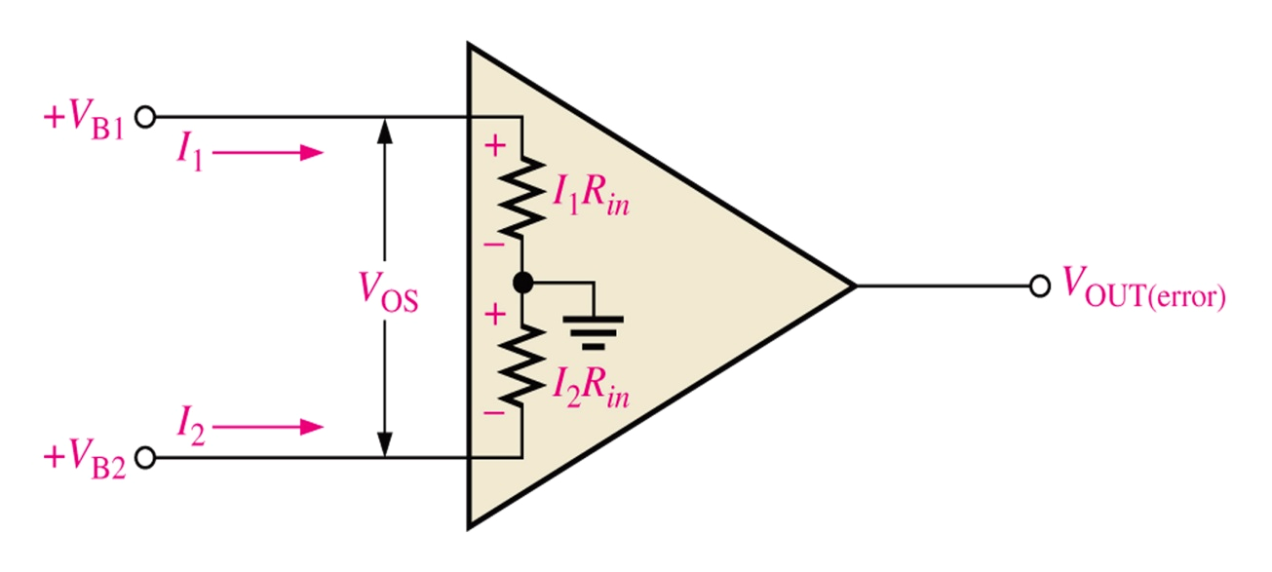
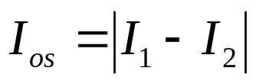



Op-Amp Parameters
Input Offset Current
  Is the difference of input bias currents
Input offset current
Offset voltage
Thus, error

Slide 19
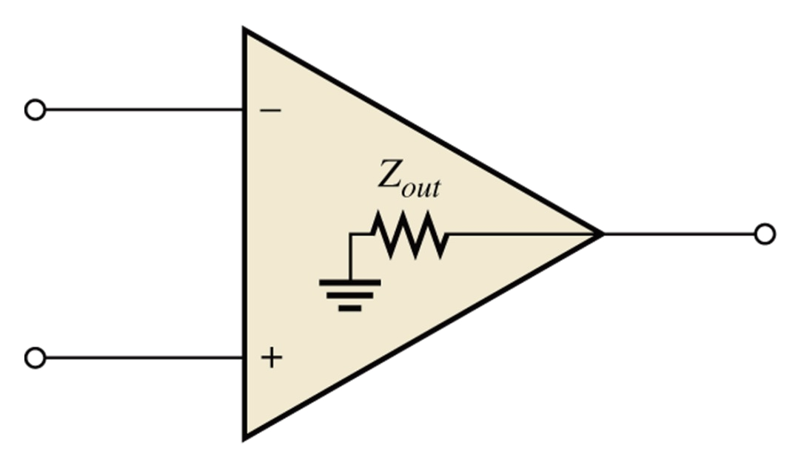
Op-Amp Parameters
Output Impedance
  Ideally should be zero
  Is the resistance viewed from the output terminal of the op-amp. In reality, it is non-zero.

Slide 20
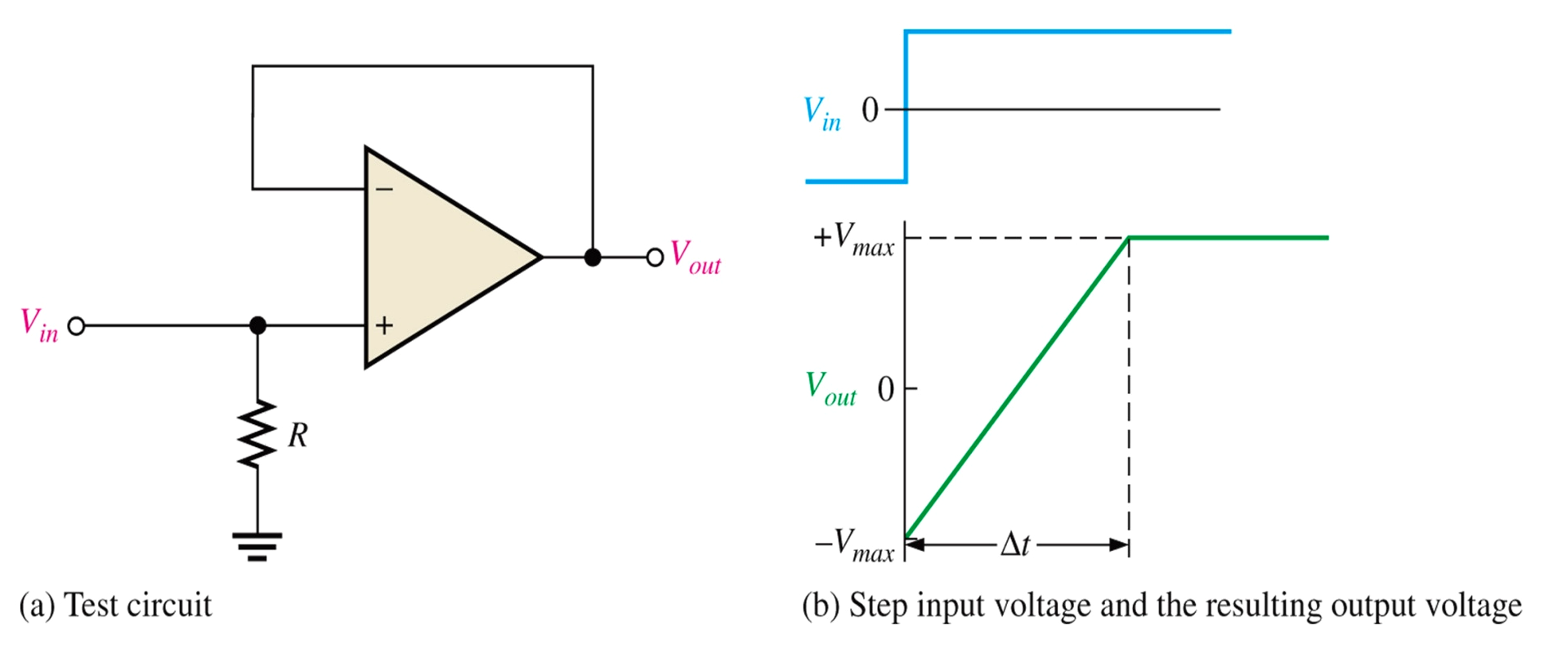
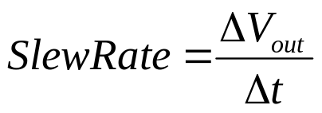

Op-Amp Parameters
Slew Rate
  Is the maximum rate of change of the output voltage in response to a step input voltage.

Slide 21
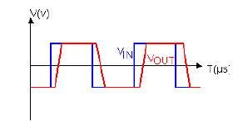
Op-Amp Parameters
Slew Rate
  It’s a measure of how fast the output can “follow” the input signal.

Slide 22
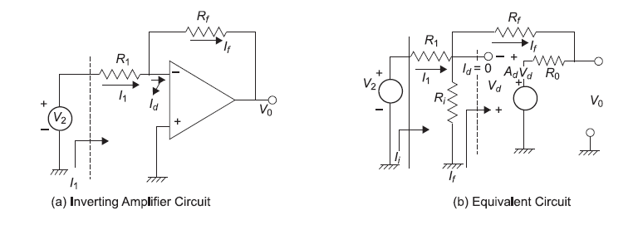
Linear Applications of Operational Amplifier
INVERTING AMPLIFIER

Slide 24
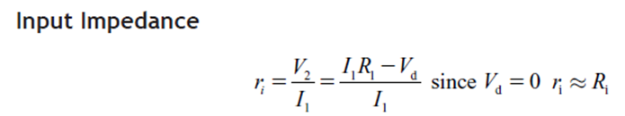

Slide 25
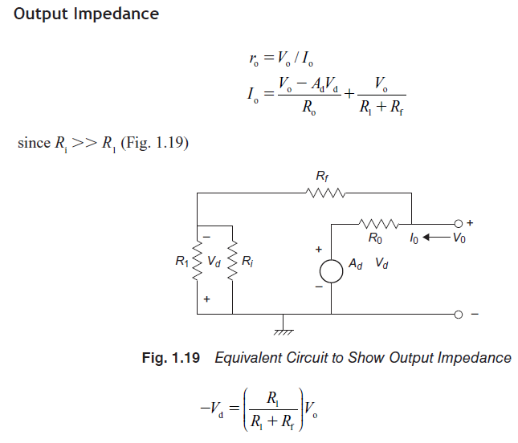

Slide 26
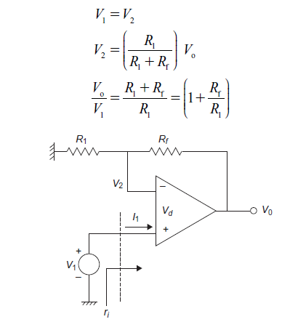
Ideal Case: Non-inverting Amplifier

Slide 27
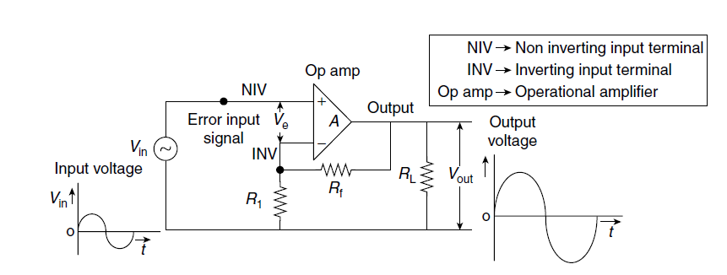

Slide 28
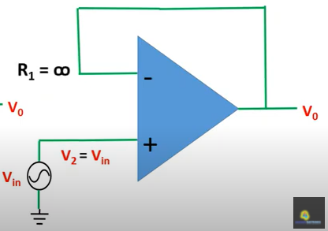
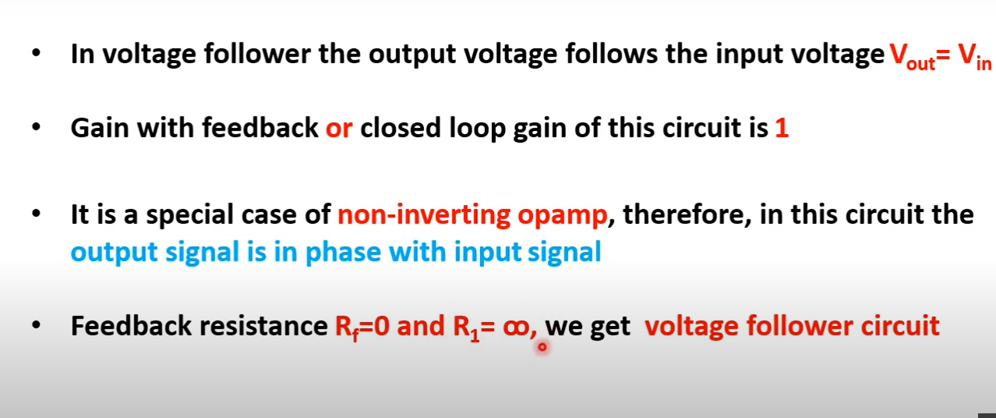
Voltage follower or Buffer

Slide 29
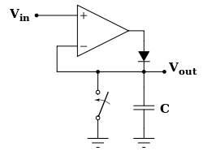
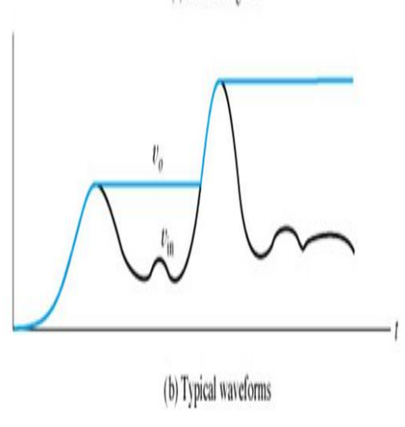
Peak detector:
The function of a peak detector is to compute the peak value of the input.
The circuit follows the voltage peaks of a signal and stores the highest value on a capacitor.The highest peak value is stored until the capacitor is discharged.
V_{out} < V_{in}; D ON and C charges to peak value of input, (i.e) voltage follower.
V_{out} < V_{in}; D OFF and C holds the peak value of input.
The circuit can be reset, capacitor voltage can be made zero by connecting low leakage MOSFET switch across the capacitor.
Applications: Measurement and instrumentation, Amplitude modulation.

Slide 30
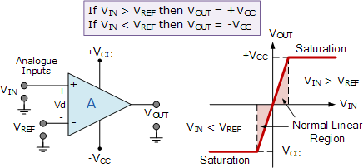
Comparator: A circuit which compares a signal voltage applied at one input of an op amp.

Slide 31
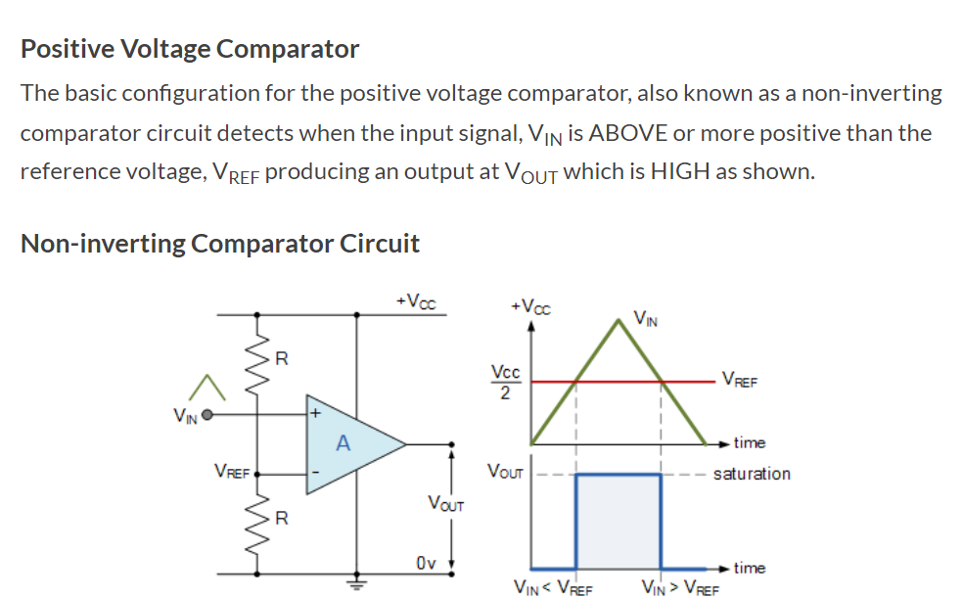

Slide 32
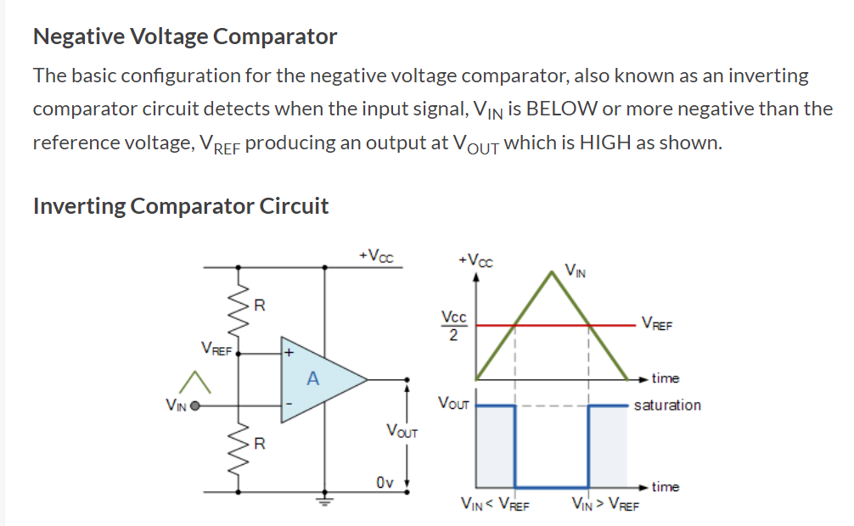

Slide 33
Example Problem

Slide 34
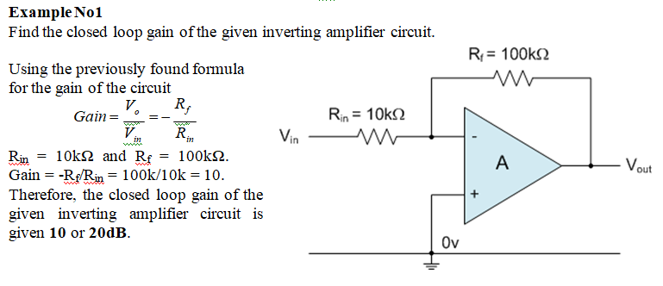

Slide 35
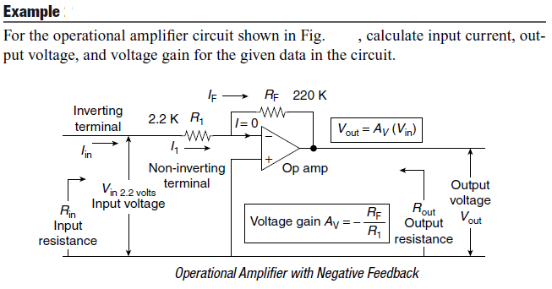

Slide 36
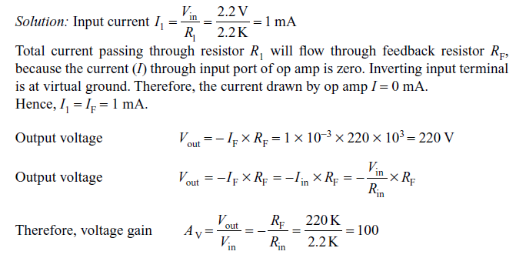

Slide 37
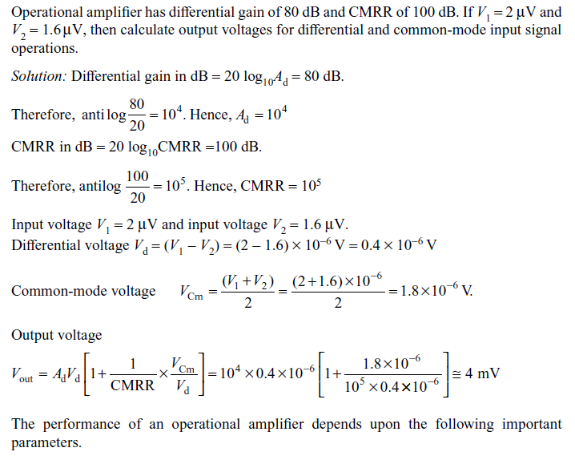
Example

Slide 38
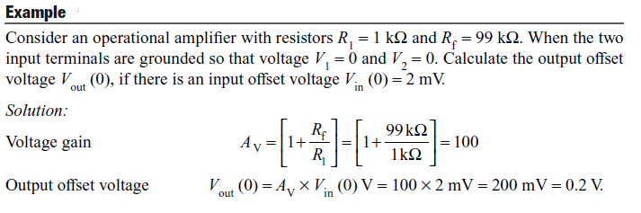

Slide 39
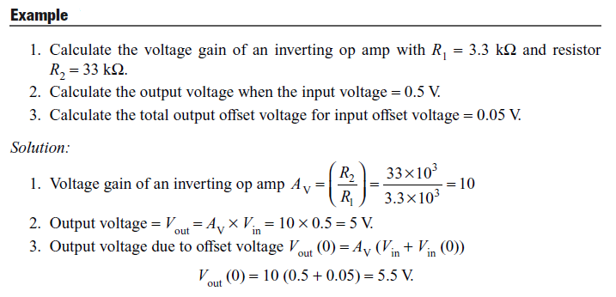

Slide 40
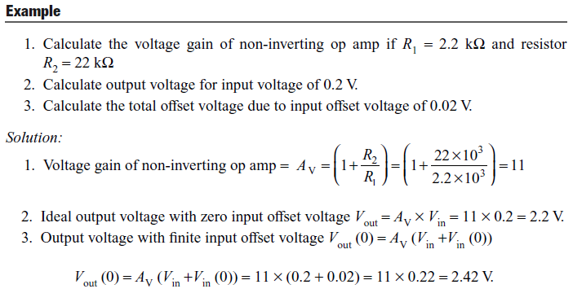

Slide 41
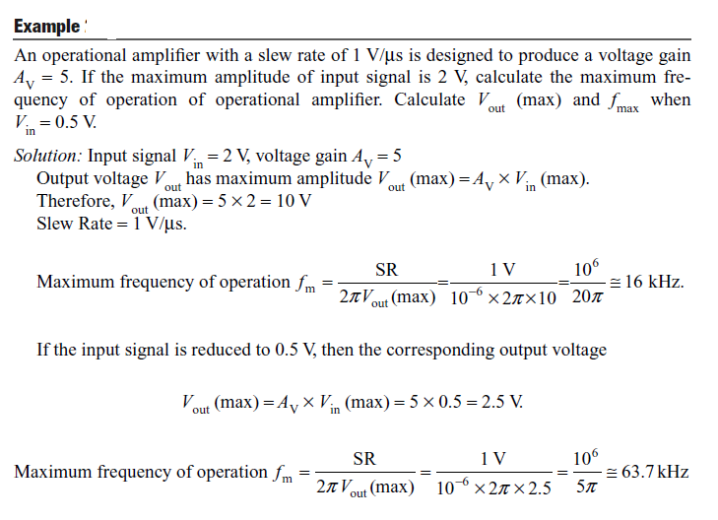

Slide 42
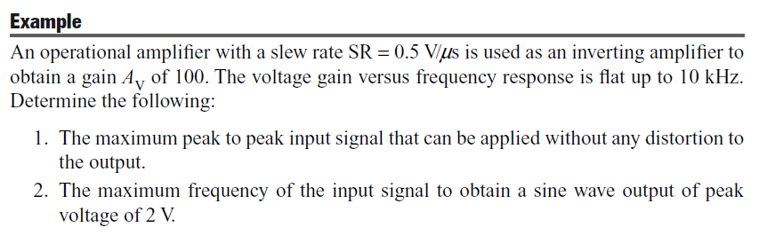
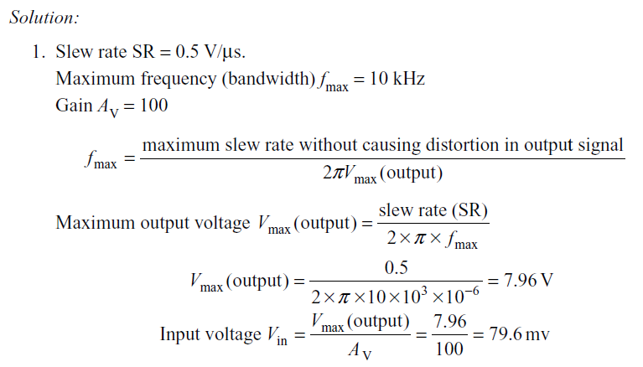

Slide 43
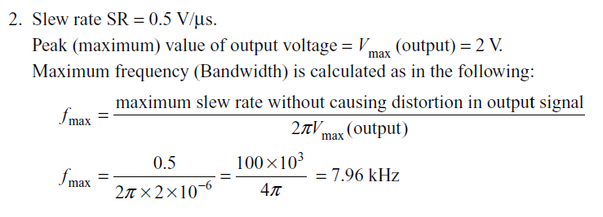
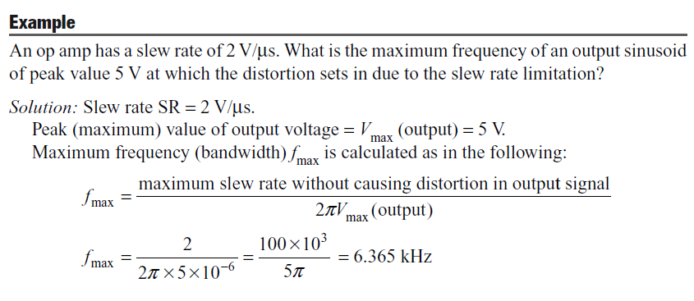

Slide 44
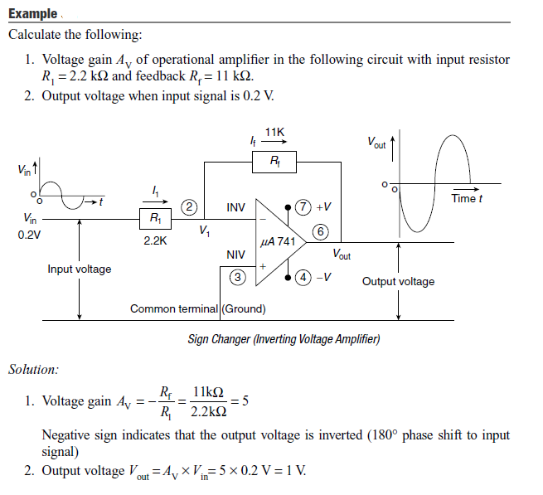

Slide 45
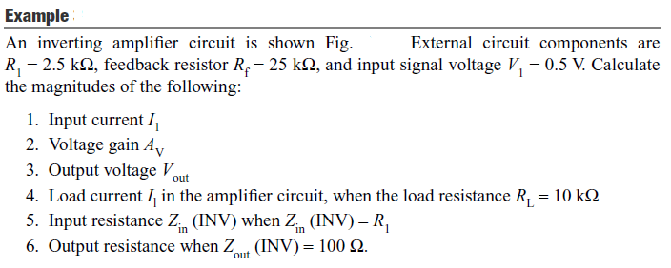
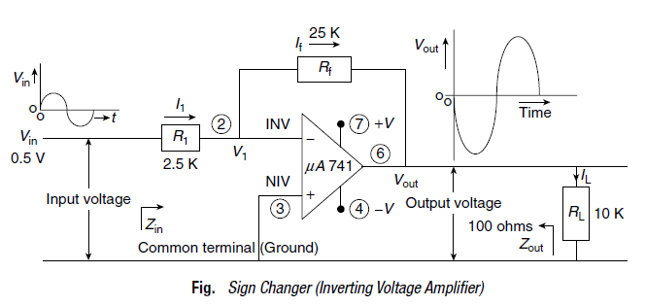

Slide 46
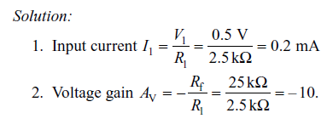
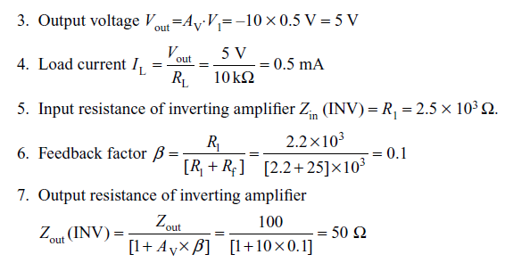

Slide 47



Slide 48



Slide 49


Slide 50


